Slide 1
Welcome
How to help your child succeed at school
Title | Presented by
Welcome & Character Education | Mrs Coles
Resilience and well-being | Mrs Gibson
The wider curriculum | Mrs Alexander & Miss Baldry
Maths | Mrs Gibson
English | Miss Starsmore
PSHCE | Miss Savage
Notes:
Opp to earn house points

Slide 2

Character is the set of personal qualities and values that guide how a person thinks, behaves, and treats others. It is about the kind of person a child is becoming. This develops over time through everyday experiences at school and at home.
Character education is the intentional teaching and development of these values, virtues, and behaviours to help young people make positive choices, build strong relationships, and contribute responsibly to their community and wider society.
Notes:
Agree – who children become matters as much as what they achieve in sch – Good citizens of the future – good people
Research shows – if chn develop virtues such as perseverance, curiosity, and self-control they’re more likely to engage positively with learning, achieve higher and be successful
These character strengths are also linked to confidence, strong relationships and a greater sense of wellbeing throughout— helping children to flourish, not just succeed
A value is a belief about what is important.
A virtue is how that belief is shown through actions and behaviour.
Example
Value: people should be treated well (what you believe)
Virtue: showing kindness (quality you develop)
Our values guide us and virtues show us

Slide 3
What Do We Mean by Good Character?
Having good character means:
Choosing what is right, even when it is difficult
Acting with kindness,honesty and integrity
Persevering through challenges
Notes:
A phrase we use with the children is ‘doing the right thing even when no one is looking’,
Because you want to be a good person, not for a reward, sticker, treat…

Slide 4
Why is Character Education Important?
Academic success alone is not enough.
Character helps children:
Build strong relationships
Cope with setbacks
Become responsible citizens
“The function of education is to teach one to think intensively and critically.” – Martin Luther King Jr.
Notes:
Can you earn a house point for your child by naming the six school virtues?
Wisdom, courage, ambition, temperance, integrity, service

Slide 5
The ultimate aim of character education is the development of good sense, or practical wisdom; the capacity to choose intelligently between alternatives.
Character education is about helping children grasp what is ethically important in situations and how to act for the right reasons.
This capacity involves knowing how to choose the right course of action in difficult situations and it arises gradually out of the experience of making choices and the growth of ethical insight.
Notes:
How do they know what is the right thing to do?
develop practical wisdom - choose to do the right thing
Sometimes this is easy and sometimes it is hard and we are all still learning
Might not be what you want to do, eg- share your toy
Now is your chance to earn a house point for your child!
Can you name the 6 school virtues, hands up

Slide 6
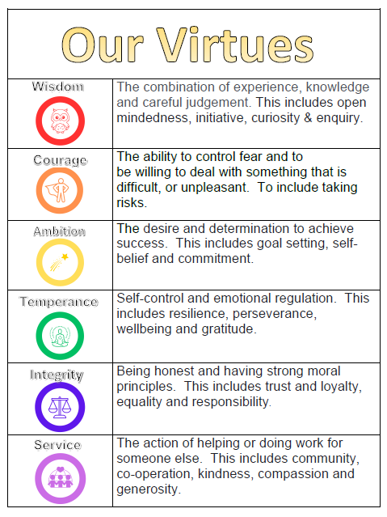

Slide 7
Caught | Taught | Sought
Clear plan for virtues/values understood by all Rewards and behaviour policy Physical environment Culture and routines Staff as role models | Curriculum – PSHCE Stand alone lessons/days Assemblies Visitors | Extra curricular offer Pupil leadership Cultural capital Volunteering/social actions

Slide 8
How parents can help to develop character:
Value character development and recognise the vital role you play your child’s character development
Model the virtues – children learn character by watching how adults speak, act, and respond to challenges. Praise effort, not outcomes – you can’t do it yet
Encourage responsibility and independence– give age-appropriate chores and expect them to be completed well.
Allow healthy struggle – resist the urge to fix every problem so children can build resilience and grit and problem-solve themselves.
Teach reflection – ask questions like “What was the right thing to do?” and “What would you do differently next time?”
Encourage service – involve children in helping others at home and in the community.
Use mistakes as learning moments – focus on growth, repair, and making better choices next time.
Celebrate good character – notice and name virtues when children show them in everyday life

Slide 9
Weblinks:
DFE - Character Education
The Jubilee Centre framework
Juniper Education article - the role of parents in developing character

Slide 10
Developing Resilience and Wellbeing

Slide 11

As part of our commitment to character education and the virtues that underpin our school ethos, a key focus of our work is helping children to develop resilience.

Slide 12
Why does it matter?
Life will include challenge, change, and disappointment
Resilience helps children cope, adapt, and recover
Strong resilience supports learning, relationships, and wellbeing
Notes:
Resilience is not about children never struggling; it’s about helping them cope when they do. Resilient children are better able to manage stress, keep going when learning is hard, and bounce back from setbacks. These skills support not just academic success, but lifelong wellbeing.

Slide 13
Wellbeing is more than just feelings
Emotional wellbeing
Social belonging and friendships
Feeling safe, valued, and included
Notes:
Wellbeing isn’t just about happiness—it’s also about feeling connected. Friendships, belonging, and positive relationships are central to a child’s resilience. We actively support social development and help children navigate friendships and challenges that come with them.

Slide 14

Resilience is not something that can be taught in isolation or gained through ease. To develop strong character, children must experience challenge. They need opportunities to try, to struggle, to make mistakes, and sometimes to fail.
Notes:
These experiences are not setbacks; they are essential steps in learning how to persevere, adapt, and grow.

Slide 15
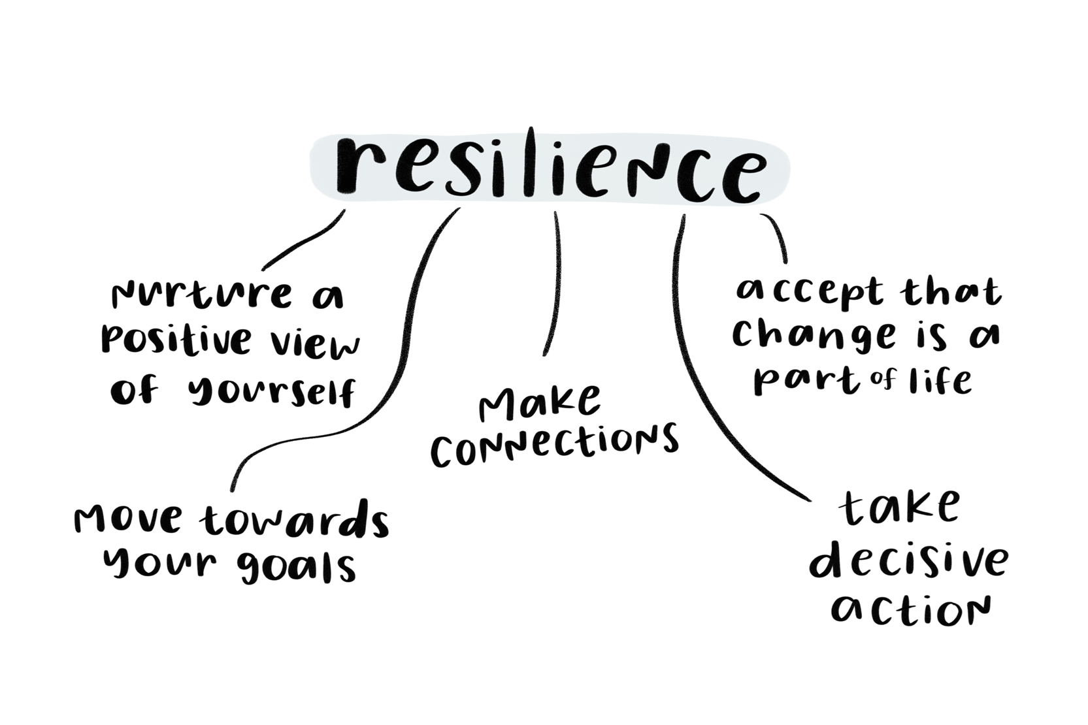
Notes:
These experiences are not setbacks; they are essential steps in learning how to persevere, adapt, and grow.

Slide 16

We grow stronger by gradually increasing the challenge
Notes:
An analogy we often use is physical training. If we go to the gym and lift the same light weights every time, our strength will not improve. We grow stronger by gradually increasing the challenge, with support and guidance. In the same way, children build emotional strength by facing age-appropriate difficulties, while knowing that trusted adults are there to support them.

Slide 17
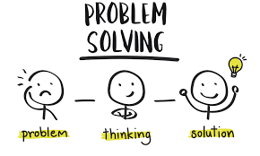
Our role as adults,both at school and at home,is to provide that support without removing the challenge. This means helping children to become problem-solvers, rather than fixing everything for them or fighting their battles.
Notes:
It means encouraging high expectations of themselves, while reassuring them that mistakes are a normal and valuable part of learning.

Slide 18
What does this look like in school?
Trying even when learning feels hard
Making mistakes and learning from them
Asking for help appropriately
Persevering with challenges
Reflecting on what could be done differently
Notes:
In school, resilience shows up in small, everyday moments: children having another go, coping with a wrong answer, or managing friendship difficulties. We actively teach and model these behaviours in classrooms and across school life.

Slide 19
Growth mindset and the power of yet
“I can’t do this… yet”
Learning happens through effort and practice
Mistakes are part of learning, not failure
Notes:
A growth mindset helps children understand that ability develops over time. The word yet is powerful—it shifts thinking from “I can’t” to “I’m still learning.” We encourage children to see challenge as an opportunity to grow, not a sign that they aren’t capable.

Slide 20
We also place great importance on talking openly about emotional wellbeing, just as we do about physical health.
Notes:
In school, we use a range of targeted intervention programmes to support children who may be struggling with self-esteem, anxiety, emotional regulation, or other wellbeing needs. These interventions work alongside our wider curriculum and pastoral care, ensuring that every child is supported to develop confidence, resilience, and a strong sense of self.

Slide 21
Parents as powerful role models
Children learn from how adults respond to stress
Calm responses build calm children
Setbacks are opportunities to model coping
Notes:
Children watch how adults deal with stress, frustration, and mistakes. When they see calm problem-solving, self-reflection, and perseverance, they learn those skills themselves. We don’t need to be perfect—just honest and reflective.

Slide 22
Validate emotions – don’t rush to fix
Acknowledge feelings: “That sounds really hard”
Emotions don’t always need fixing
Support problem-solving when they’re ready
Notes:
When children are upset, our instinct is often to fix the problem immediately. However, validating their feelings helps them feel heard and understood. Once emotions are settled, they are far more able to think and problem-solve for themselves.

Slide 23

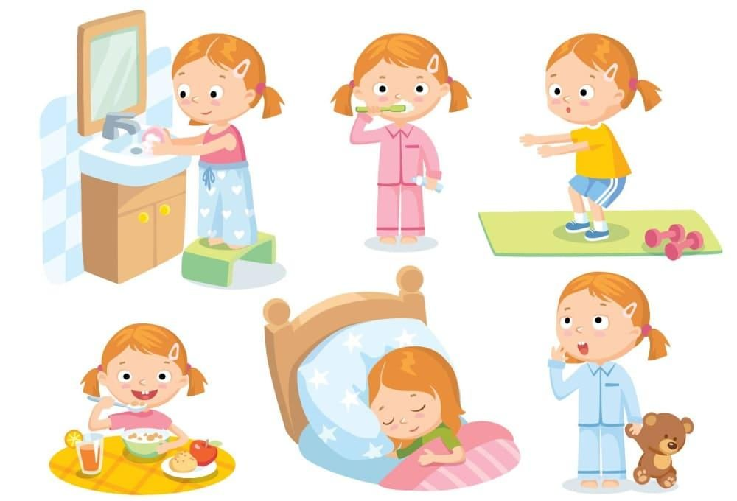
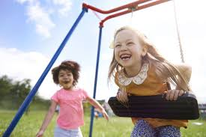
A safe and predictable environment is essential for this process. Consistent routines help children feel secure and ready to learn.
Good sleep Calm & Routines Down-time
Notes:
A safe and predictable environment is essential for this process. Consistent routines help children feel secure and ready to learn. Good sleep, calm and structured morning routines, completing homework tasks, and having time for rest and relaxation all play an important role in supporting wellbeing and resilience.

Slide 24
When should you be worried?
Persistent anxiety or low mood
Changes in sleep, behaviour, or friendships
Avoidance of school or activities
Big changes from usual behaviour
Notes:
All children experience ups and downs. Concern arises when difficulties are persistent, worsening, or impacting daily life. Trust your instincts—if something doesn’t feel right, it’s okay to ask for support.

Slide 25
What to do
Talk to your child
Speak to class teacher or school staff
Early support makes a difference

Slide 26
NHS – Supporting a Child or Young Person
Comprehensive advice for parents/carers on recognising and supporting mental health needs in children and young people, including anxiety and depression, plus links to urgent help if needed. https://www.nhs.uk/mental-health/children-and-young-adults/mental-health-support
NHS – Advice for Parents
A parent-friendly section of the NHS website with guidance on talking about feelings, anxiety, depression, anger and more. https://www.nhs.uk/mental-health/children-and-young-adults/advice-for-parents/
YoungMinds (Parents Helpline & Guides)
A major UK child mental health charity offering advice, toolkits and a free parents helpline for those concerned about their child’s emotional wellbeing. https://www.youngminds.org.uk/parent/
Childline (for the Child Themselves)
Free, confidential support children and young people can access directly — includes phone and online counselling and self-help resources. https://www.childline.org.uk/
Place2Be Counselling and Parent Support
A UK children’s mental health charity offering in-school counselling, family support, blogs and guidance on understanding emotional issues. https://www.place2be.org.uk/

Slide 27

By working together (school and home) we can help children develop the resilience they need not only to succeed academically, but to thrive in life beyond the classroom.

Slide 28
Welcome & Purpose
The importance of a Broad and Balanced Curriculum
We will discuss:
What your child learns at school
How learning is organised
How you can support your child’s learning and development
Notes:
This presentation explains how our curriculum is planned to support every child academically, creatively and socially. I will outline the curriculum at Turvey primary and how you can support your child’s learning and development.

Slide 29
What Is a Broad and Balanced Curriculum?
Covers all National
Curriculum subjects
Develops knowledge, skills and values
Supports the whole child
Reading stories linked to history topics
Using maths skills in real-life problem-solving
Learning teamwork through PE and group projects
Notes:
Why are knowledge, skills and values important - because together they shape how a child thinks, acts, and relates to others. knowledge gives children information and understanding about themselves and the world around them. Skills allow children to apply what they know in real-life situations and Values shape a child’s attitudes, behaviour, and sense of right and wrong

Slide 30
Subjects Included
English and Maths
Science (taught as a standalone subject)
History & Geography
Art, Music, Design & Technology
PE, Computing, PSHE & RE
Modern Foreign Language in KS2
Classroom examples:
Writing diary entries as historical characters
Mapping local areas in Geography
Designing and building simple structures in DT
Notes:
Ensures that all interests and abilities are catered for and that all government requirements are met.

Slide 31
Why Science Is Taught as a Standalone Subject
Encourages curiosity and questioning
Develops investigation skills
Builds strong scientific understanding
What you can do to encourage this:
Growing plants and observing changes over time
Investigating materials to see which float or sink
Simple experiments with magnets or circuits
Notes:
Science is a statutory requirement. It needs to be allocated a portion of the timetabled week. Children’s results are reported to borough and nationally.

Slide 32
Creativity Is Paramount
Creativity across all subjects
Encourages problem-solving
Builds confidence and independence
Examples:
Designing posters or models to show learning
Creating music to reflect emotions or stories
Finding multiple ways to solve a maths problem
Notes:
Vis the broad and balanced curriculum we are hoping to develop the children’s creativity, not just in the product they create but how they go about it. being creative with solutions, approaches, strategies. Looking outside the box and having that vision to try a different idea.

Slide 33
Curriculum Mapping
Carefully planned coverage
Clear progression of skills
Avoids gaps and unnecessary repetition
Progression examples:
Building writing skills from sentences to paragraphs
Developing scientific enquiry skills year by year
Revisiting key concepts with increasing depth
How can you support your child?
Look at the progression documents on the school website.
Read the newsletters which come home at the start of each term.
Pre / over learning of topics with your child.
Support homework.
Notes:
We spent a long time redesigning our curriculum a few years ago. We worked really hard on ensuring it showed progression and covered the skills required. We ensured there are cross curriculum links and that the children understand how these concepts relate to each other.

Slide 34
Yearly & Two-Yearly Curriculum Cycles
Long-term curriculum planning
Ideal for mixed-age classes
Ensures full coverage of content
Classroom examples:
History topics alternating (e.g. Ancient Egypt one year, Romans the next)
Science topics revisited with increasing complexity
Geography skills applied to different locations each cycle
Notes:
As you know some of our classes are mixed and have 2 year groups in them. We have to ensure we don’t teach the same thing twice so we follow a Year A map and Year B map. In some cases we learn completely new concepts, in other subjects we build on what we already know.

Slide 35
How All This Benefits Your Child
Strong academic foundations
Creative and critical thinkers
Confident, curious learners
How can you support your child?
Encourage them to explaining their thinking aloud
Be independent when completing project work
Show collaborative problem-solving activities
Give them first hand experiences.
Notes:
Aiming to create well rounded young people who can challenge themselves, work independently and overcome obstacles. We want pupils to be confident, enthusiastic and resilient.

Slide 36
Working Together
What will make a difference?
How can I shape my child’s knowledge?
Do we have good work ethics and attitudes?
Have we established positive routines and habits?
Parents as partners
Communication and support
Notes:
It needs to be a partnership. As teachers we can give them the skills and teach them how but the children need you, their, parents to support and nurture them, to allow them to flourish.

Slide 37
Physical Education and Sport – What does it look like at Turvey?
At least 2 hours of curriculum time
Raising activity levels and aims for pupils to get 60 mins of daily activity – 30 mins in school via PE, active breaks/assemblies, golden mile
Pe kit days
Moki bands in KS2
Cross curricular links
Range of afterschool clubs
Inter school competitions and fixtures
Termly sports festivals per class
Healthy Living Week
Working alongside our School sport partnership
PE premium
Classroom examples :
Weekly house competition for activity levels – Moki Bands
Clubs – Footgolf, dodgeball, dance, yoga, football, rugby, multi-skills
Alternate football and netball leagues each year – Y5&6
Opportunities to access a wide range of high quality PE and sport opportunities both within schools and our local communities with School Sports Partnership
Range of opportunities to be active and try new adventurous activities during Healthy Living Week
Notes:
At Turvey Primary we believe that Physical Education, experienced in a safe and supportive environment is a vital contributor to a pupil’s physical development and well-being. It is therefore our intention to provide an inclusive, broad and balanced Physical Education curriculum. This is not just about the 2 hours of Physical Education they receive on a weekly basis but ensuring that they have a good understanding of the importance of physical activity and how to lead a healthy lifestyle, physically and mentally. The aim is for all pupils to be active for at least 60 minutes a day of moderate or vigorous activity – 30 minutes at school via PE, active breaks/assemblies, golden mile and at least 30 minutes at home.

Slide 38
PE and sport premium
Examples that benefit the children:
Table tennis table, Multi-use goals, Traverse climbing wall
Variety of playground equipment
Additional equipment for the curriculum to support progression
EYFS resources
GetSet4PE scheme of work
Additional swimming interventions
Healthy Living Week workshops and inspirational individuals – GB Paralympian
CPD and training for staff
Transport for competitions, fixtures and swimming
School Sports Partnership package
Specialist Tennis coaching in the Summer term for the whole school
£16,000 per school each academic year to use for the following five indicators:
Indicator 1: Increased confidence, knowledge and skills of all staff in teaching PE and sport
Indicator 2: Engagement of all pupils in regular physical activity
Indicator 3: The profile of PE and sport is raised across the school as a tool for whole school improvement
Indicator 4: Broader experience of a range of sports and activities offered to all pupils
Indicator 5: Increased participation in competitive sport
Notes:
So how does this benefit your child? We identify areas that we feel needs improvements each year. The indicators are the barriers in which we report the spending of the sports premium too and throughout the year these are examples of how the sports premium is used to benefit your child. Staff CPD and training is used to make sure our knowledge is up-to date and provides high quality teaching for all pupils, we replenish the equipment that is required for both lessons and active break times and we recognise the importance of offering a range of clubs, activities and workshops with inspirational individuals, especially during our HLW

Slide 39
How can you support your child
How can you make a difference?
Encourage active play every day
Teach fundamental movement skills – help your child to ride a bike, swim, throw, skip, climb, balance
Be active as a family
Support healthy sleep routines
Encourage them to participate in clubs, activities within or outside of school
Limit screen time
Make activity part of daily life
Being role models for your child/ren to look up to
Making healthy choices, mentally, physically and emotionally
Being active together
Helping support your child to learn life skills
Notes:
Encourage active play every day
Set aside time for outdoor play, walking, scooting, or games.
Let children move in a way they enjoy—running, dancing, climbing, skipping, or playing ball.
2. Teach fundamental movement skills
Help children learn to ride a bike, swim, throw, catch, balance, and jump.
These skills build confidence and help them enjoy being active as they grow.
3. Be active as a family
Go for family walks
Visit the park together
Choose active weekend activities (swimming, hiking, cycling)
4. Support healthy sleep routines
Good sleep makes children more ready to learn and play. Parents can help by:
Keeping consistent bedtimes and wake-up times
Creating a calming bedtime routine
Reducing screen time before bed
5. Limit screen time
Encourage breaks from screens and replace some screen time with movement or outdoor play.
Set simple limits—e.g., “Move for 30 minutes before screen time.”
6. Make activity part of daily life
Walk or cycle short journeys when possible
Take stairs instead of lifts
Include quick movement breaks at home

Slide 40
In Summary
Turvey Primary will ensure:
A Broad, balanced and
inclusive curriculum
Creativity is at the heart of
learning
Carefully planned curriculum for progression
Parents will:
Establish good routines and habits.
Expand their child’s learning.
Encourage independence and creativity.
Notes:
Working together as school and home is one of the most powerful ways to help children thrive. Hopefully this has highlighted manageable changes that can make a real difference!

Slide 41
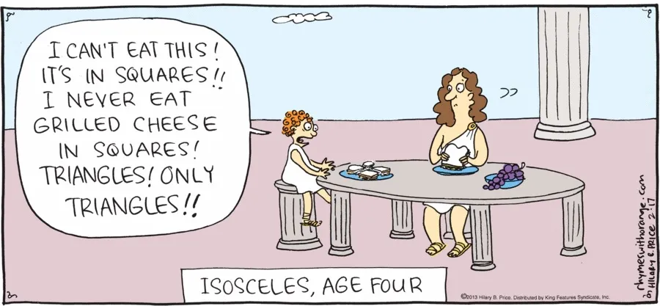
Supporting Your Child with Maths

Slide 42
Aims
Understanding modern maths teaching
How maths develops from Reception to Year 6
How parents can support at home
Notes:
This presentation explains how maths is taught today, why it may look different from when many parents were at school, and how you can support your child confidently at home.

Slide 43
Why Maths Matters
Develops logical thinking and reasoning
Builds problem-solving and resilience
Essential life skill
Notes:
Maths is about much more than numbers. It teaches children how to think, reason, and persevere—skills needed for everyday life and future learning.

Slide 44
The Mastery Approach (White Rose Maths)
Fewer topics, greater depth
Small steps build understanding
Fluency, reasoning, problem solving
Notes:
We follow a mastery approach using White Rose Maths, focusing on depth, secure understanding, and confidence rather than rushing through content.

Slide 45
Curriculum Overview
Reception: number sense and counting
Year 1: addition, subtraction, early fractions
Year 2: number, 4 operations, times tables, division, fractions
Year 3–4: all times tables, formal methods of calculation
Year 5–6: short methods, fractions, decimals, percentages, algebra
Notes:
Key concepts are introduced early and revisited regularly, allowing children to deepen understanding year by year.

Slide 46
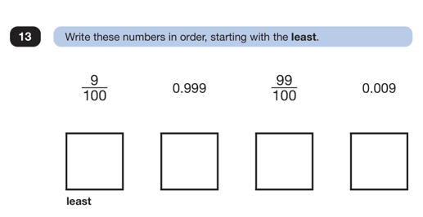
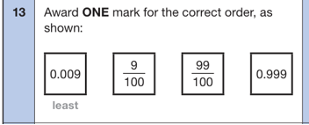
Time to have a go!

Slide 47
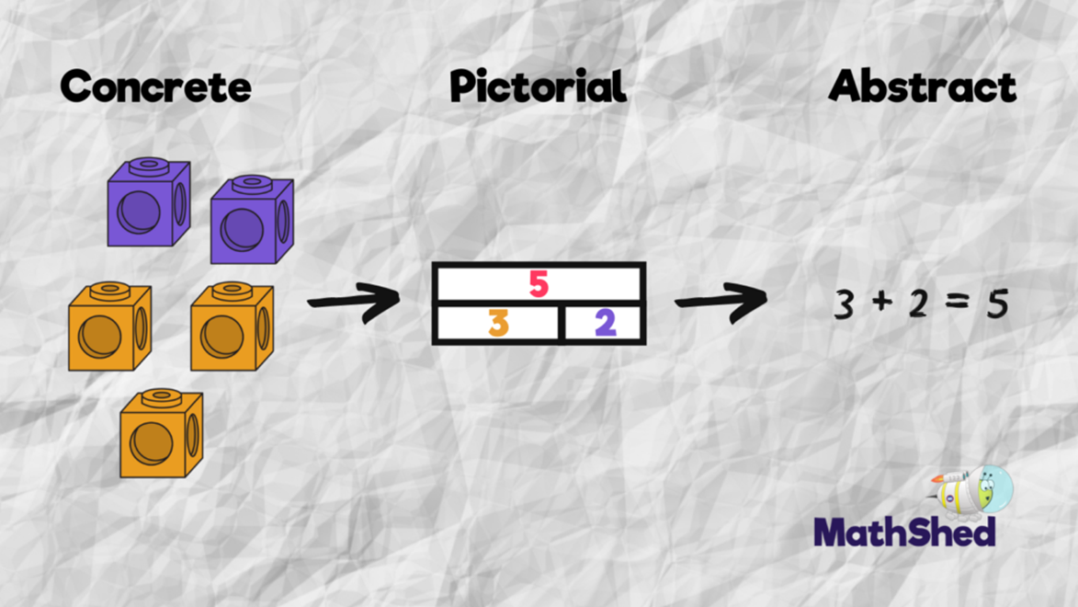
Concrete–Pictorial–Abstract (CPA)
Concrete resources
Pictorial models and drawings
Abstract numbers and symbols
Notes:
Children move through CPA to build secure understanding. Using equipment and drawings shows deep learning, not weakness.

Slide 48
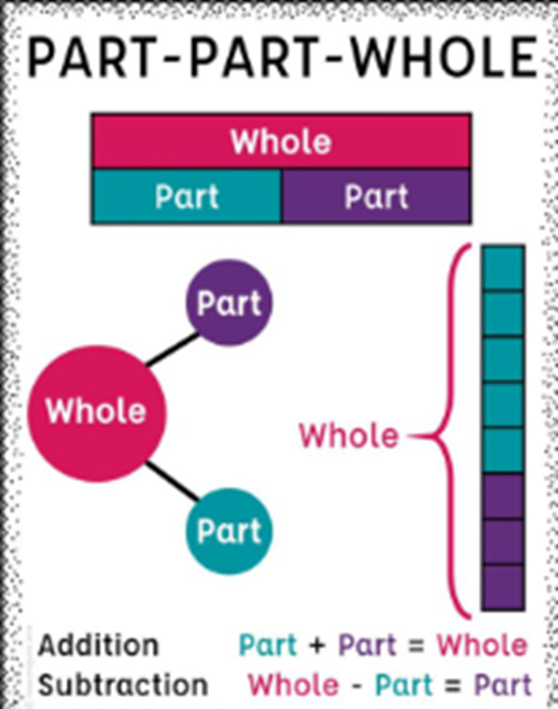
Part–Part–Whole
Numbers made of parts
Used across all operations
Supports reasoning and fluency
Notes:
Part–part–whole helps children understand relationships between numbers and underpins all four operations and fractions.

Slide 49
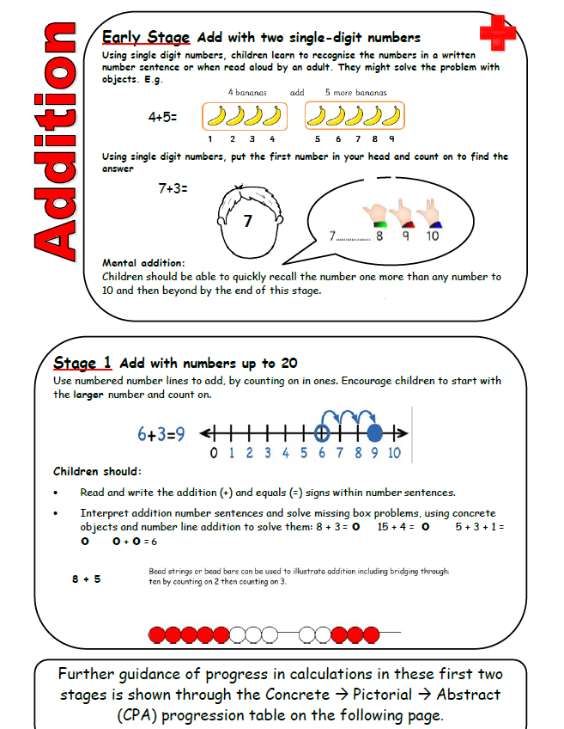
Calculation Policy
Understanding before efficiency
Consistent models
Progressive methods
Notes:
Our calculation policy follows White Rose guidance, ensuring children understand why methods work before moving to formal written approaches.

Slide 50
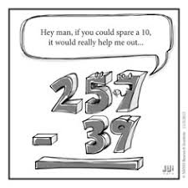
Addition and Subtraction
Number bonds
Bar models and number lines
Formal written methods later
Notes:
Children secure number bonds and place value before moving to written methods, ensuring understanding rather than memorisation.

Slide 51
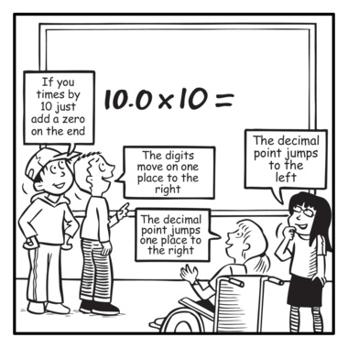
Multiplication and Division
Equal groups and arrays
Times tables from Year 2
Links between operations
Notes:
Multiplication starts with grouping and arrays. Times tables are taught early and division alongside multiplication to show connections.

Slide 52
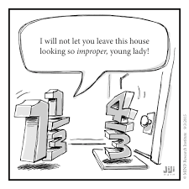
Fractions
Introduced early
Fractions as part of a whole
Strong visual models
Notes:
Fractions are taught from Year 1 and 2 using concrete and pictorial models to prevent misconceptions later.

Slide 53
Mathematical Language
Precise vocabulary
Explaining thinking
Reasoning in every lesson
Notes:
Using correct mathematical language helps children explain their thinking and deepen understanding.

Slide 54
Fluency
Recall of key facts
Efficient methods
Confidence with numbers
Notes:
Fluency is about accuracy and flexibility, not speed alone. Secure fluency supports problem solving.

Slide 55
Supporting Maths at Home
Be positive
Ask children to explain
Use everyday maths
Notes:
Parents do not need to teach methods. Talking about maths and encouraging explanation is highly effective.

Slide 56
Tip 1 – Understanding the basics
Does your child know the counting sequence up to 20?
Can your child count a number of objects up to 20 accurately, touching or moving one object at a time?
Can your child quickly recognise a number of objects between 1 and 10 in a ten-frame or on fingers without counting?
Can your child count up and down, starting on any number between 1 and 20?
Can your child recognise that numbers can be partitioned?
Has your child begun to understand place value?

Slide 57
Tip 2 – Number Bonds
Number bonds are pairs of numbers that add up to certain totals e.g. 3 + 7 = 10. A good understanding of number bonds is important for nearly every part of maths your child will learn. The most important number bonds are those that add up to 10.
4 + 6 = 10
Children should understand the relationship between 4, 6 and 10 and the different ways these three numbers can interact. So they should understand that 4 + 6 = 10 is the same as 6 + 4 = 10, and that 10 – 6 = 4 or 10 – 4 = 6 are the reverse.
Once your child is happy with numbers bonds up to 10, you will want to move on to number bonds up to 20 and to 100.

Slide 58
Tip 3 – Multiply and divide
Your child may have learnt the very basics of multiplication in Year 1, but it is covered much more heavily in Year 2, and division is introduced for the first time.
Learn times tables!
One of the simplest ways to look at multiplying is repeated addition. 5 x 2 can be seen as 2 lots of 5 (or 5 + 5). Equally, 2 x 5 can be seen as 5 lots of 2 (or 2 + 2 + 2 + 2 + 2.) Develop this understanding by showing this using objects.
Division can be explained in terms of grouping and sharing. Grouping involves seeing a calculation such as 10 ÷ 2 as, “How many groups of 2 can be made from 10?” While sharing involves seeing 10 ÷ 2 as, “If I share 10 into 2 equal groups, how many are in each group?”

Slide 59
Tip 4 – Problem solve
It is really important that deep connections are made between the abstract form of writing calculations, and what they represent in real life.
Find ½ by folder paper, and by counting half the sweets or cakes.
Follow a recipe and weigh ingredients. Maybe double the ingredients to make twice as many.
One of the most important things to do at this stage is to try and incorporate maths into everyday life in fun and engaging ways

Slide 60
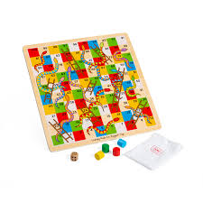
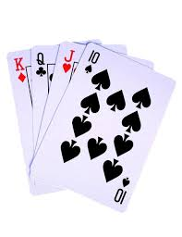

Tip 5 – Play with numbers
Increase fluency by :
Playing board games
Playing card games
Playing darts
Use Sumdog and TTRockstars

Slide 61

When Maths Feels Hard
Struggle is part of learning
Encourage perseverance
Mistakes are valuable
Notes:
Maths provides opportunities to develop resilience. Encourage effort and reassure children that mistakes help learning.

Slide 62
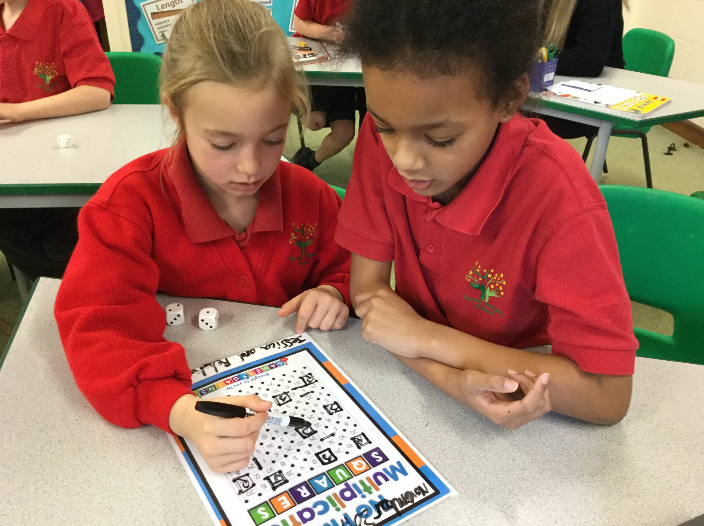
Support in School
High-quality teaching
Small group support
Careful monitoring
Notes:
We monitor progress closely and provide targeted interventions where needed.

Slide 63
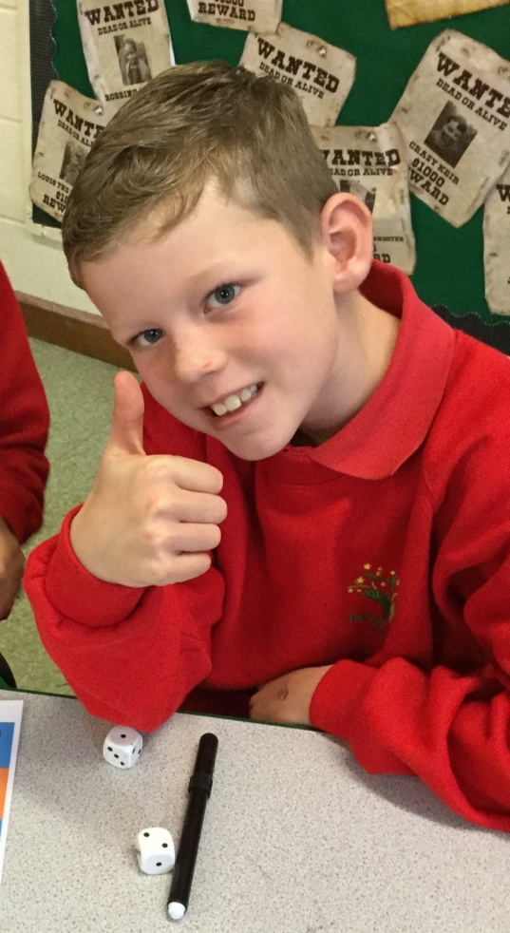
Working Together
Understanding first
Confidence and resilience
School and home partnership
Notes:
When school and home work together, children develop strong maths skills and a positive mindset.

Slide 64
Why is English important?
English underpins all learning across the curriculum
We aim for children to:
Communicate confidently
Read for pleasure and understanding
Write clearly, creatively and accurately
Strong English skills support:
Academic success
Confidence and wellbeing
Future life and work opportunities

Slide 65
What is Oracy?
Oracy = speaking and listening skills
Children learn to:
Speak clearly and confidently
Listen carefully and respond thoughtfully
Use appropriate vocabulary
Express opinions and ideas
The new oracy framework supports:
Structured talk in lessons
Discussion, debate and presentation skills

Slide 66
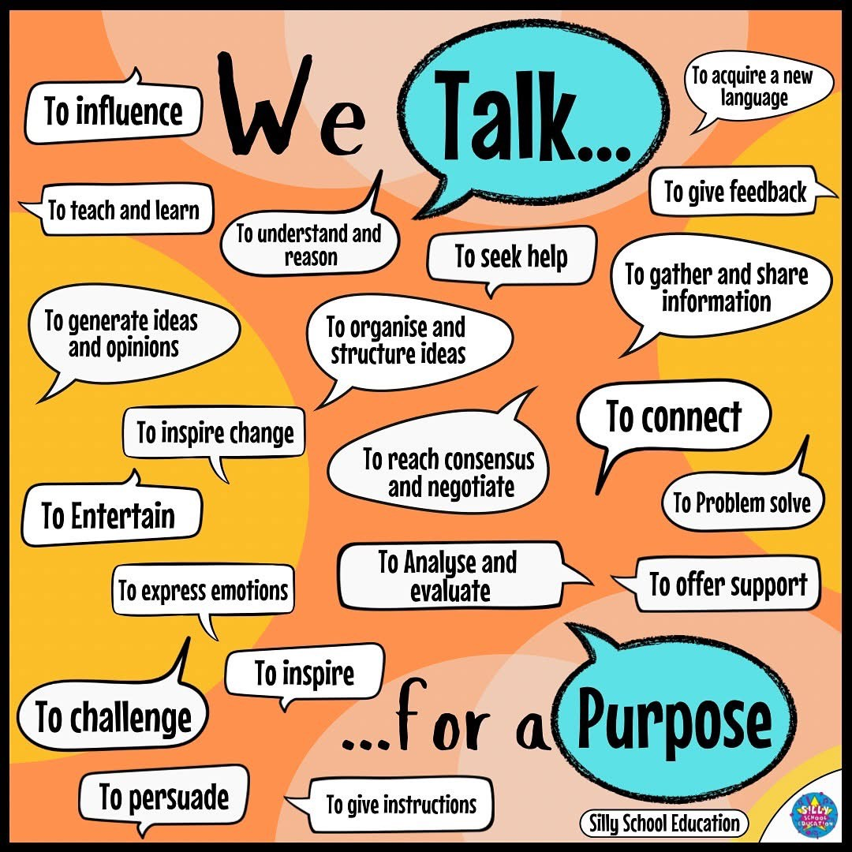

Slide 67
Phonics – building blocks of reading
Phonics teaches children:
How sounds link to letters
How to blend sounds to read words
How to segment sounds to spell
Taught daily in Early Years and Key Stage 1
Builds a secure foundation for reading and writing

Slide 68
Developing Life Long Readers
Children learn to:
Read accurately and fluently
Understand and discuss texts
Explore different genres and authors
Improve comprehension skills
Reading includes:
Phonics-based reading
Guided reading
Reading for pleasure

Slide 69


Reading Vipers
V
I
P
E
R
S

Slide 70


Reading Vipers
Vocabulary
Infer
Predict
Explain
Retrieve
Summarise

Slide 71
If your child reads for 20 minutes a day, how many words will they be exposed to in 1 year?

Slide 72
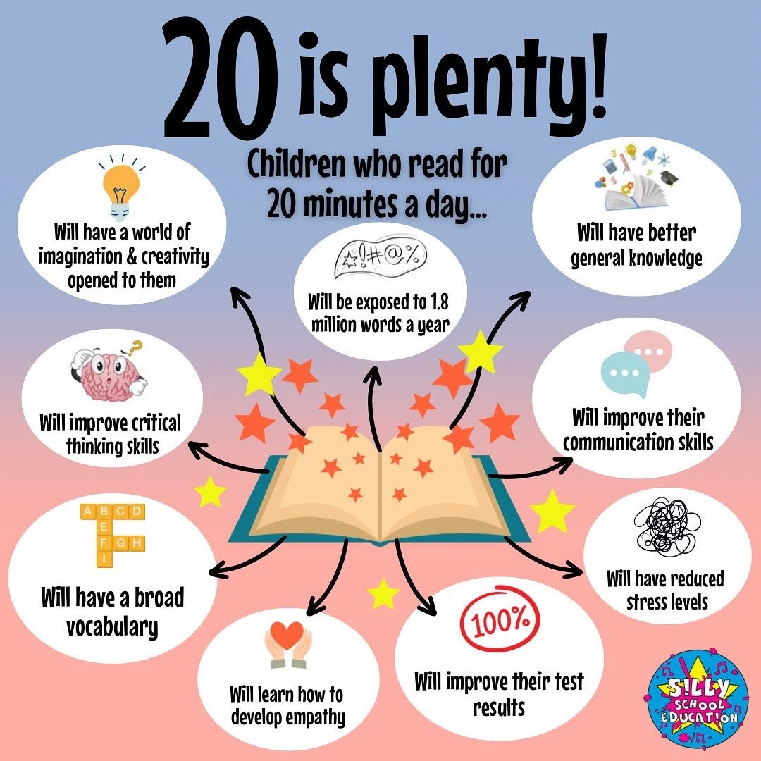

Model fluent
and expressive
reading

Slide 73
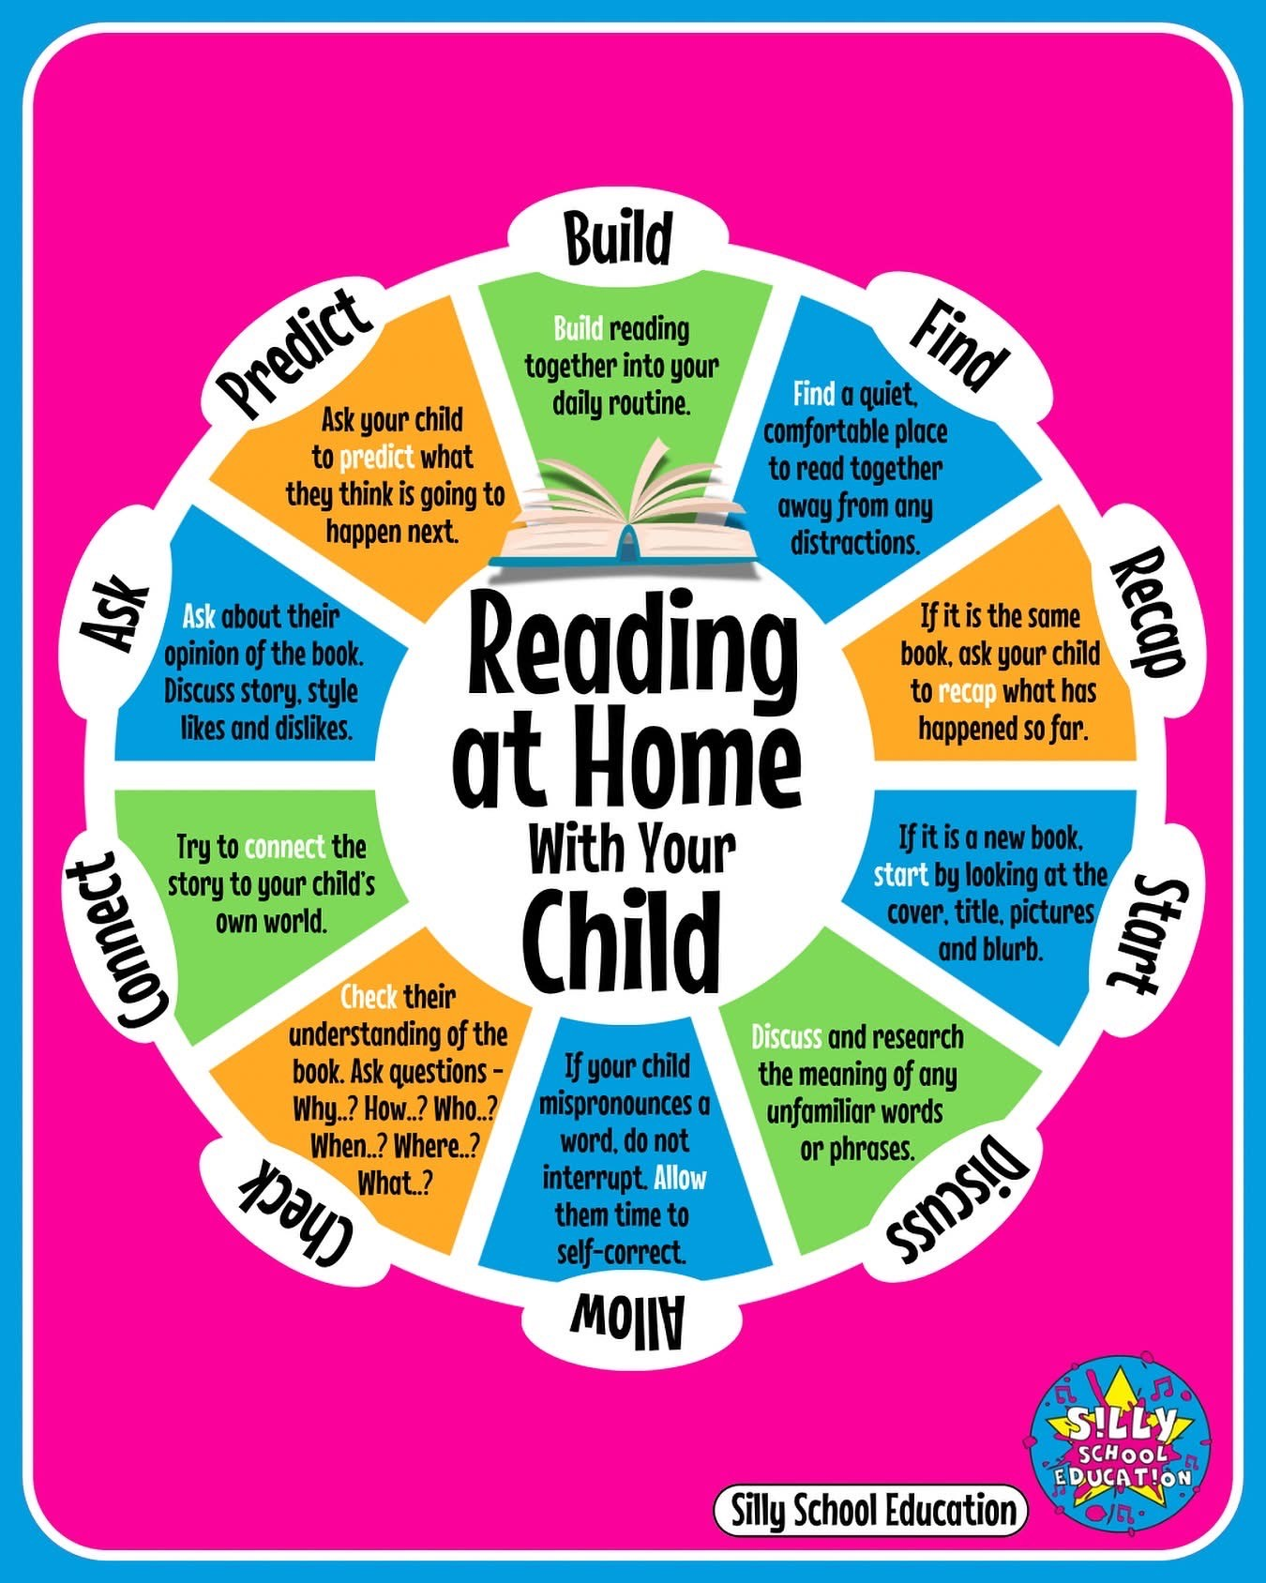

Slide 74
Writing – From ideas to paper
Children are taught to:
Write for different purposes
Use rich vocabulary
Use correct grammar and punctuation
Develop handwriting and spelling
Writing is carefully linked to:
Reading
Talk and discussion

Slide 75


Slide 76

Encourage talk before they write
Provide opportunities for real-life writing
Retell events
Praise ideas, effort and creativity, not just spelling and handwriting!
Build rich vocabulary – use ambitious words and explain new ones
Reassure them that mistakes are part of learning

Slide 77

What is a subordinating conjunction?
What is a determiner?
What is a polysyllabic word?

Slide 78
What is PSHCE?
Personal, Social, Health & Citizenship Education
Wellbeing, relationships and life skills
Preparation for life

Slide 79
PSHCE at Turvey
Building resilient, confident learners
Follow our school virtues
Using the SCARF programme

Slide 80
Why PSHCE matters?
Builds confidence and self-esteem
Supports mental health
Encourages safe choices
Not just an ‘extra’ lesson

Slide 81
The SCARF Programme

Slide 82
How PSHCE is taught?
Weekly lessons
Discussion and reflection based– “ask it basket”
Safe learning environment

Slide 83
Our School Virtues
School Virtue | How PSHE Supports It
Temperance (self-control, balance) | Helps children manage emotions, resist peer pressure, and make thoughtful choices.
Service (helping others, caring) | Encourages empathy, teamwork, and supporting peers.
Integrity (honesty, doing the right thing) | Builds honesty, fairness, and ethical decision-making.
Ambition (striving to achieve, self-motivation) | Supports goal-setting, resilience, and confidence.
Courage (facing challenges, standing up for right) | Teaches children to speak up, try new things, and face difficult situations safely.
Wisdom (thinking, reflecting, making good decisions) | Encourages reflection, decision-making, and learning from experiences.
Foundation of
every lesson.
Real life scenarios.

Slide 84
Linking to everyday scenarios
Hands up if you have had to make a choice today?
Keep your hand up if you had to think about the risks and then decide
Keep up if you want to discuss what the choice was and your decision behind it.

Slide 85
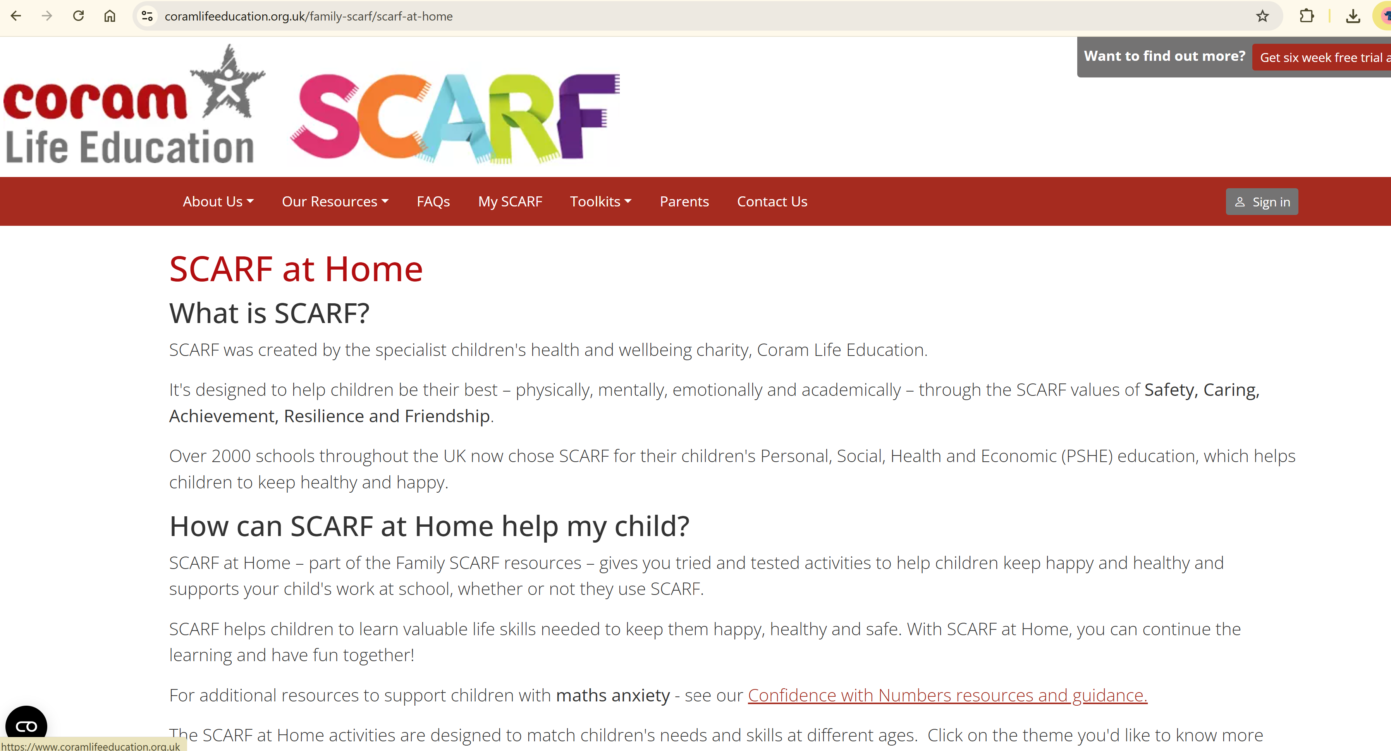
How Parents Can Help
Talk about feelings
Reinforce messages
Encourage problem-solving

Slide 86
Working Together
School and home partnership
Consistent messages
Supporting wellbeing

