Slide 1


Sats Information Session

Slide 2

What are SATs?
SATs stands for Statutory Assessment Tests and are held at the end of Key Stage 1 [Year2] and Key Stage 2 [Year 6]

Slide 3


How are children assessed?
There are two ways your child is assessed:
Teacher Assessment
&
SATs tests

Slide 4

Teacher Assessment
Teacher assessment draws together everything the teacher/teachers know about the child, using a range of evidence from lessons, observations, marked work and school assessments.
Teacher assessment is not a ‘snapshot’: it shows the bigger picture and is therefore more reliable than a test.

Slide 5

Teacher Assessment- writing
The children do not need to sit a writing test! ☺
Instead, the children are assessed by their teacher and progress is monitored across the year to ensure the most accurate assessment is given to your child. Your child’s teacher will gather information about your child’s writing from across the curriculum and identify whether they are:
Below the expected standard
Working towards the expected standard
Working at the expected standard
Working above the expected standard.

Slide 6

The Tests
Key Stage 2 SATs take place nationally in the week commencing Tues 9th May 2023.
Tests will be administered in the following subjects:
Reading (60 minutes for 3 texts: fiction, non-fiction and poetry)
Spelling (approximately 15 minutes)
Punctuation, Vocabulary and Grammar (45 minutes)
Mathematics
- Paper 1: Arithmetic (30 minutes)
- Paper 2: Reasoning (40 minutes)
- Paper 3: Reasoning (40 minutes)

Slide 7
Timetable
Tuesday 9th May – SPAG paper and Spellings
Wednesday 10th May – Reading
Thursday 11th May – Mathematics paper 1 & 2
Friday 12th May – Mathematics Paper 3

Slide 8

KS2 Spelling, Punctuation, Grammar
Within this test, children will be sitting a spelling test which tests 20 words. This test is approximately 15 minutes long.
A separate test is given on Punctuation, Vocabulary and Grammar which lasts for 45 minutes and requires short answer questions, including some multiple choice questions. There are approximately 42-46 questions worth either 1 or 2 marks each.
Marks for these two tests are added together to give a total score out of 70 for Spelling, Punctuation and Grammar.

Slide 9
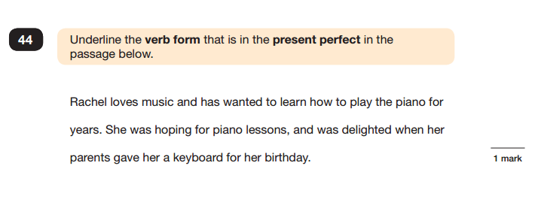
Underlining questions

Slide 10
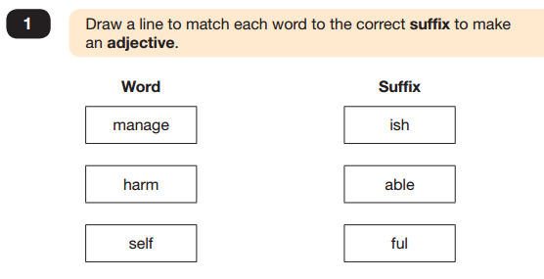
Matching questions

Slide 11
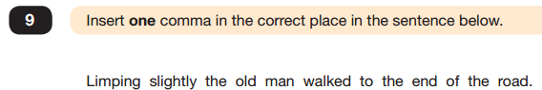
Adding-in questions

Slide 12

The spelling test
There are 20 spellings in each test. These words test spelling rules the children have worked on during their time in school.
KS1 – Sharks live in the ………..
KS2 – Mum hit her ……… with the hammer

Slide 13

Reading test – KS1
The Reading Test consists of 2 test papers.
Paper 1 has a fiction and non fiction text
Paper 2 consists of 3 short texts with a separate answer booklet.
Children are given 55 minutes in total, which includes reading the texts and answering the questions.
Questions are designed to assess the comprehension and understanding of a child’s reading.
Some questions are multiple choice or selected response, others require short answers and some require an extended response or explanation.

Slide 14
Reading test - KS2
The Reading Test consists of a single test paper
with three unrelated reading texts from a selection
of genres.
Children are given 60 minutes in total, which includes reading the texts and answering the questions.
Questions are designed to assess the comprehension and understanding of a child’s reading.
Some questions are multiple choice or selected response, others require short answers and some require an extended response or explanation.

Slide 15
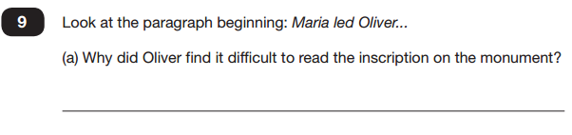
One word/sentence answers
Other questions require children to write one word, a phrase or a sentence as their answer.

Slide 16
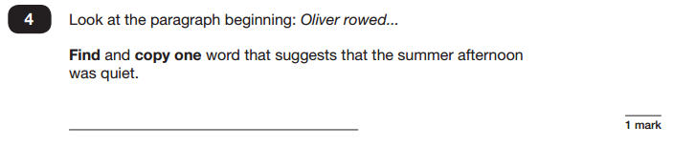
Find and copy answers
There has been an increase, in find and copy questions in SATs papers. In these types of questions, children must answer the question by choosing a word or phrase from the text and writing it exactly in their answer.

Slide 17
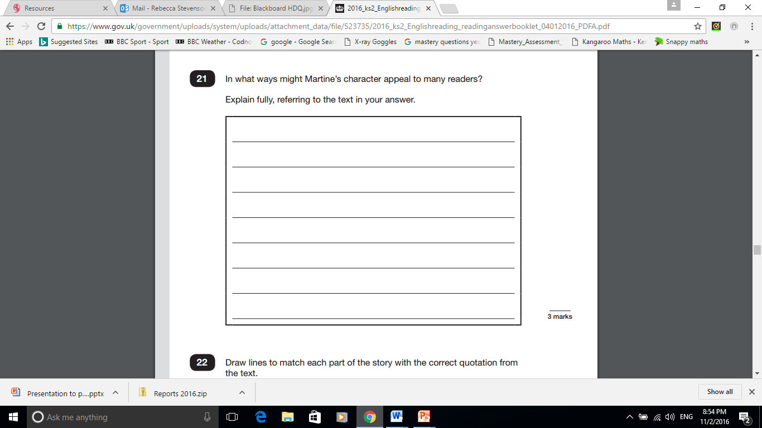
Detailed answers.
Some answers require children to write a longer, more detailed response. These questions are usually worth three marks. Children have been learning to go ‘APE’: to Answer, Prove [using a quote], and Explain their answer: this method helps them to structure their answer correctly to get the most marks.

Slide 18
KS2 Mathematics
Children will sit three tests: Paper 1, Paper 2 and Paper 3.
Paper 1 is for ‘Arithmetic’ lasting for 30 minutes, covering calculation methods for all operations, including use of fractions, percentages and decimals.
Questions gradually increase in difficulty.
Papers 2 and 3 cover ‘Problem Solving and Reasoning’, each lasting for 40 minutes. There are NO calculators allowed in any of this year’s tests so the children will rely solely on their skills.
Pupils will still require calculation skills but will need to answer questions in context and decide what is required to find a solution.

Slide 19
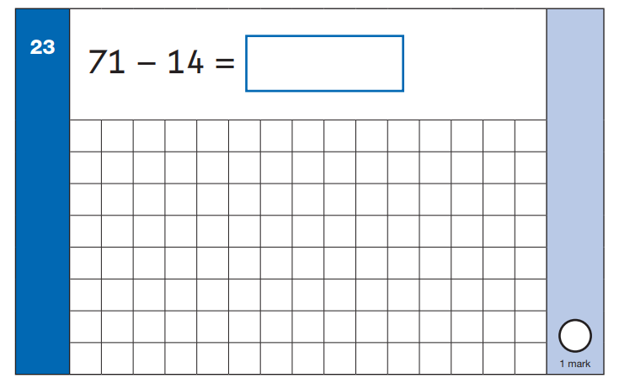
KS1 Arithmetic paper
20 minute test
25 questions
25 Marks

Slide 20
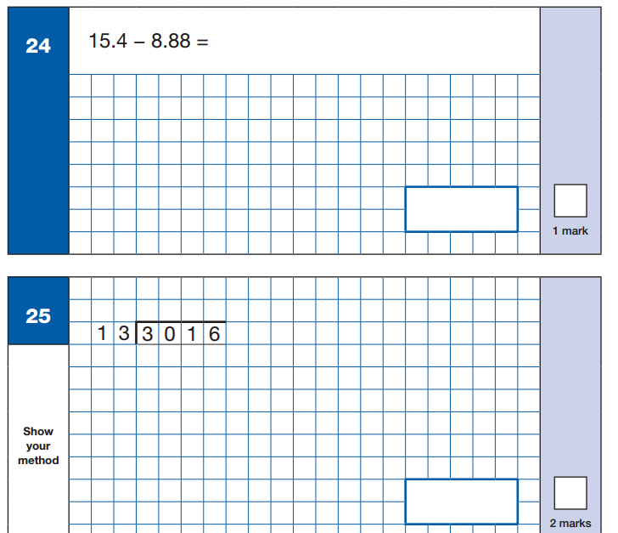
KS2 Arithmetic paper
30 minute test
36 questions
Either 1 or 2 marks per question depending on the subject
Out of 40

Slide 21

Arithmetic paper
The arithmetic paper tests:
Addition
Subtraction
Multiplication
Division
Missing numbers
Fractions
Square numbers (KS2)
Decimals and percentages (KS2)
Mixed numbers/improper fractions (KS2)

Slide 22
Reasoning papers
There are two reasoning papers: 2 and 3. in KS2
These papers focus more on testing children’s problem solving skills, with mathematical questions hidden within word problems and more complex problems.
Again, the questions in this test increase in difficulty.

Slide 23
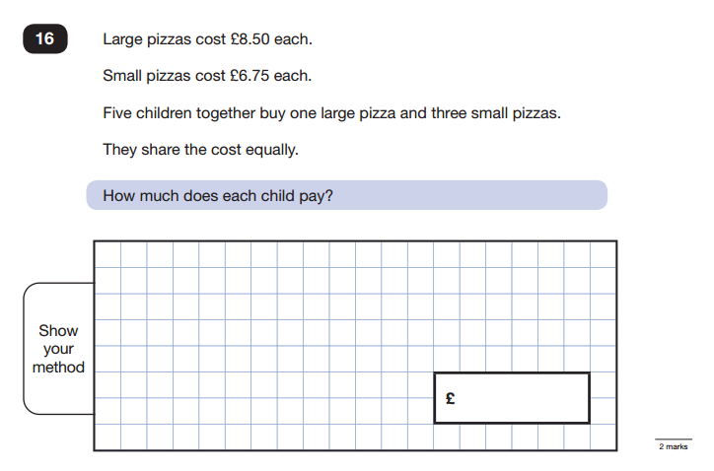
KS2 Mathematics

Slide 24
How are the SATs assessed?
Children are no longer given levels from their tests.
Test scores will be reported as ‘scaled scores’.
KS2 SATs tests are marked externally, so papers are sent away from school. We receive the scores online in July.

Slide 25
What are scaled Scores?
The government have outlined that the ‘National Average’ scaled score is 100: that is, all Year 6 children should meet this score in their SATs tests. This is decided by making comparisons with the other children across the country who took the same test.
Each pupil’s raw test score will therefore be converted into a score on the scale, either at, above or below 100.
We receive the scaled score conversion tables in June direct from the government.
A child who achieves the ‘national standard’ (a score of 100) will be judged to have demonstrated sufficient knowledge in the areas assessed by the tests.

Slide 26

Scaled Scores examples
A child awarded a scaled score of 100 is judged to have met the ‘national standard’ in the area judged by the test.
A child awarded a scaled score of more than 100 is judged to have exceeded the national standard and demonstrated a higher than expected knowledge of the curriculum for their age.
A child awarded a scaled score of less than 100 is judged to have not yet met the national standard and performed below expectation for their age.

Slide 27

Wellbeing
Most importantly, the well-being of your children is my priority!

Slide 28



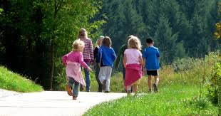
SATs week
We aim to make SATs week as normal, relaxed and stress-free as possible for the children.
How you can help:

Slide 29

Nothing to worry about!
First of all, it is really important that the children feel calm and relaxed about their SATs. All we want to see is for children to do their best and they won’t do their best if they are feeling worried!

Slide 30

Attendance
Make sure your child has the best possible attendance in school.

Slide 31


