Slide 1
Mental Health & Wellbeing
Turvey Primary School

Slide 2

Mental health affects how we think, feel & behave.
It affects how we feel about ourselves and other people and it affects our day-to-day lives.

Slide 3

Good Mental Health
You are able to cope with the ups and downs of life.
You will enjoy spending time with friends and family and have hobbies and interests you like.

Slide 4

Poor Mental Health
You might find that the things you used to enjoy doing aren’t fun anymore.
It can affect your mood, your sleep, how you get along with other people and generally make it more difficult to get on with life.

Slide 5
Rising concern for children
Among children of primary school age (5 to 10 year olds), 14.4% had a diagnosable mental disorder in 2020, an increase from 9.4% in 2017. (NHS Digital)
The pandemic saw an upheaval of access to in-person education and there was a seismic increase to the development of mental health disorders in the population at this time.
A Government report found that school-aged children active in play dropped from 53.2% to 31.4% at this time. Such sharp declines in physical play were reported to have directly increased children’s levels of anxiety and childhood obesity. Notably, many early years children are reported to need constant reassurance to try new things, engage in play and interact with other children.

Slide 6
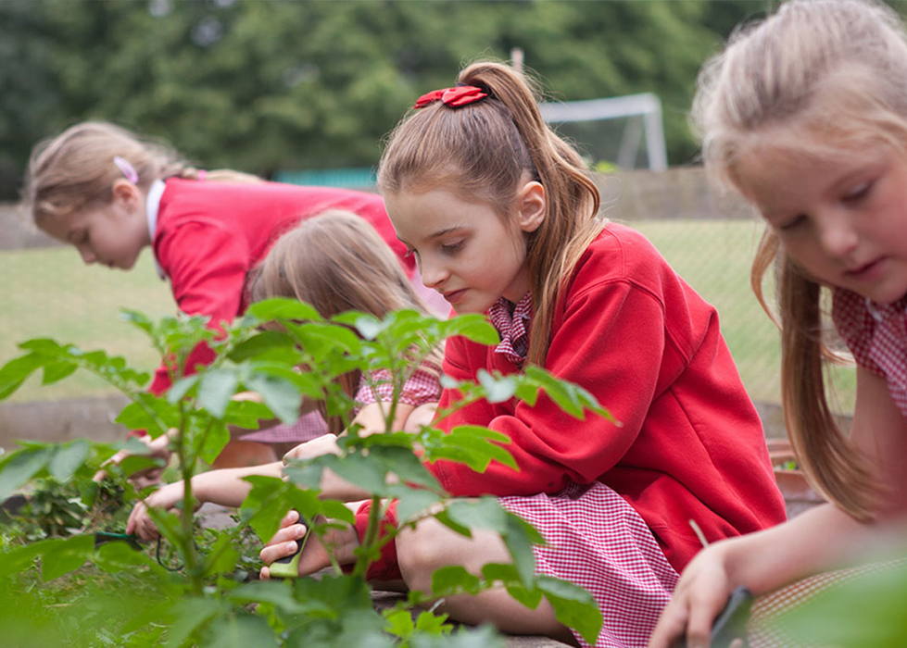
Good mental health and wellbeing is fundamental to our ability to think, interact positively with others, enjoy life and cope with worries and stress.
At Turvey Primary School, the mental health and wellbeing of our whole community is a priority.
We understand that children learn best when they feel safe, happy and healthy. We actively promote physical and mental health and equip our pupils with the skills and knowledge to help them lead healthy lives, now and in the future.

Slide 7
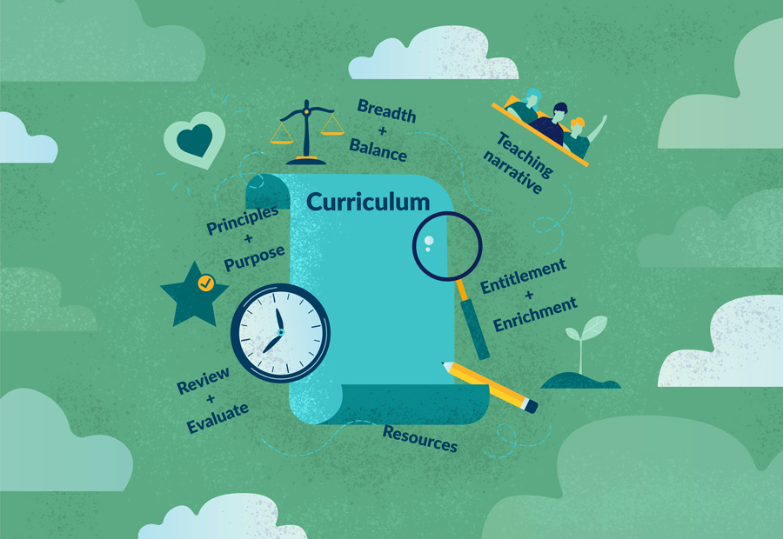
Universal Provision
All children are taught the skills and knowledge they need to lead healthy and safe lives. This is interwoven through our PSHCE, Science, PE and Computing curriculum, but is a feature of many other areas of the curriculum as well.

Slide 8
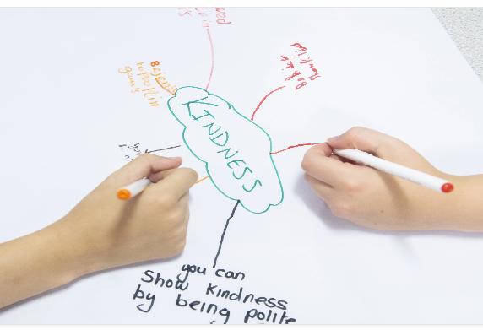
Social and Emotional Skills
These skills can improve academic attainment and enhance pupils’ motivation, as well as promote wellbeing and help prevent mental health difficulties from developing.

Slide 9
identify and manage their feelings and their behaviour, and reach out for help where necessary
build and manage healthy relationships
have self-control
resolve conflict
be self-aware
handle and overcome difficulties
make good decisions
build resilience, self-esteem and confidence
think positively about themselves and how they perceive the world around them
recognise and prevent poor mental health
grow into well-rounded and healthy adults.

Slide 10
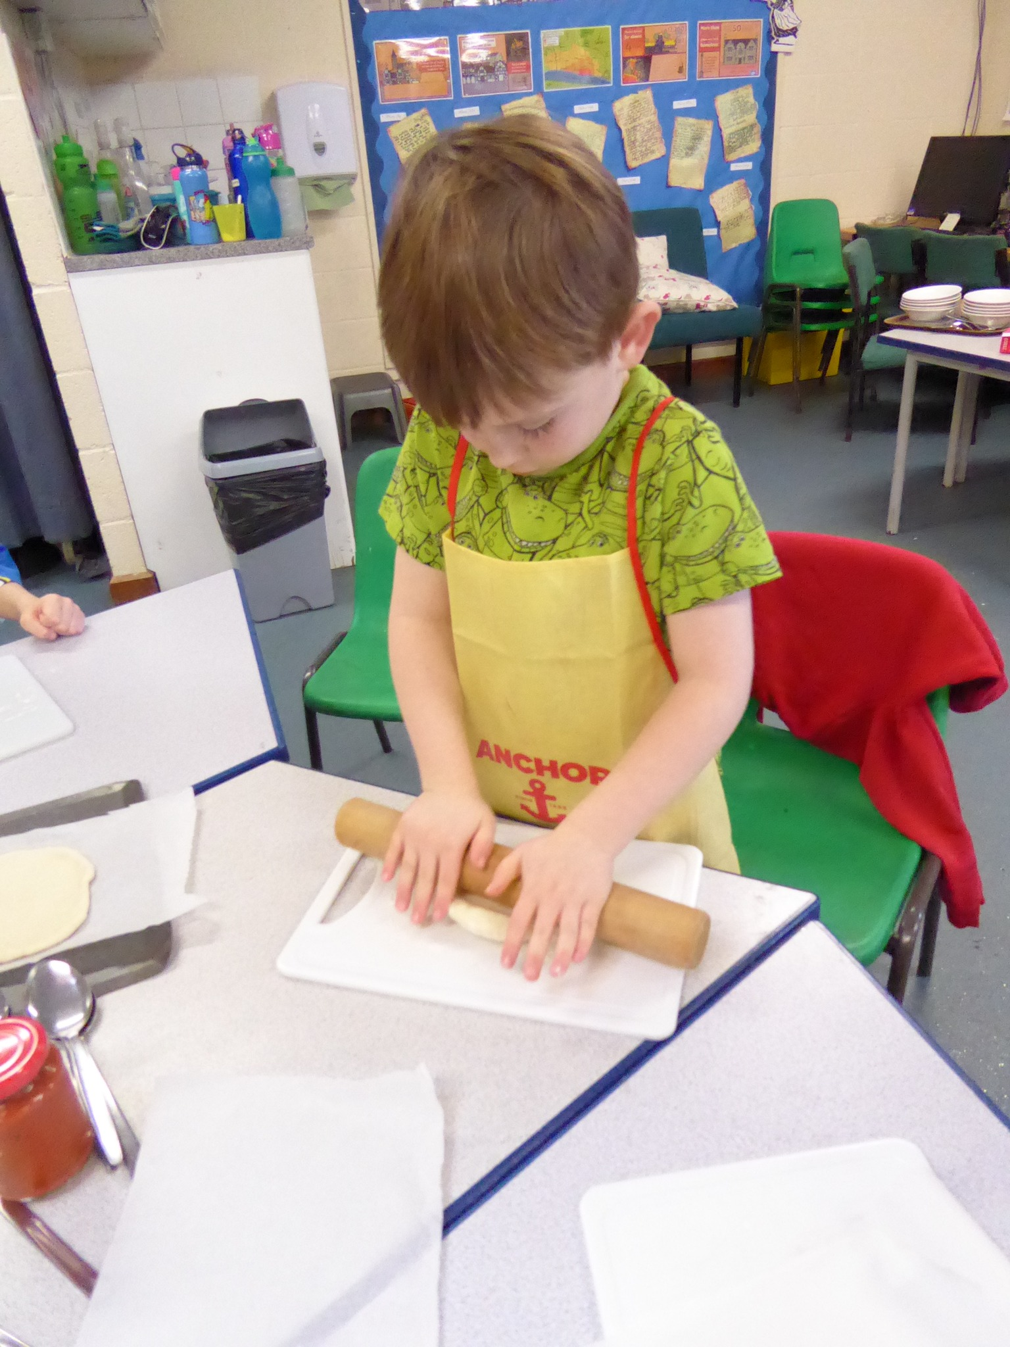
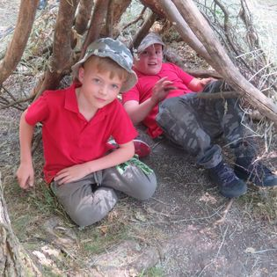
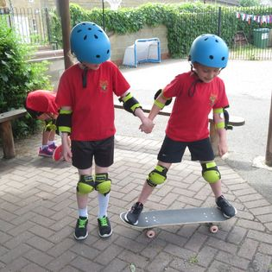
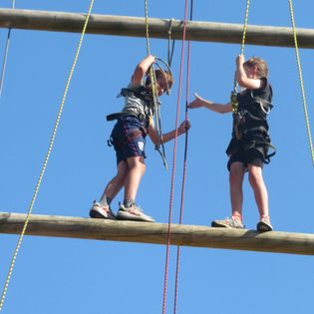
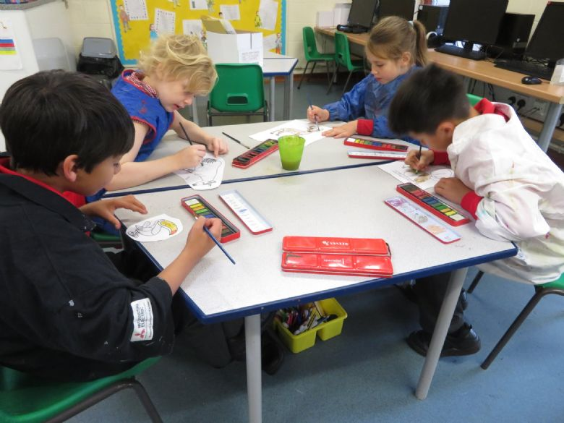
Enrichment of our curriculum
100 things to do before I leave Turvey Primary
Healthy Living Week (June)
Mental Health Week (Feb)
Creative Arts Week (March)
Golden Time (weekly)
Growth Mindset
Special Person
Star chart rewards system
Star of the week

Slide 11

Character Education
Character Education is the wider personal development of a child beyond the academic education they receive in school. It aims to instill in pupils a number of key characteristics and values.

Slide 12

Our 6 character virtues
Ambition
Temperence
Wisdom
Courage
Service
Integrity

Slide 13
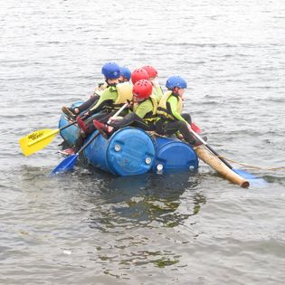
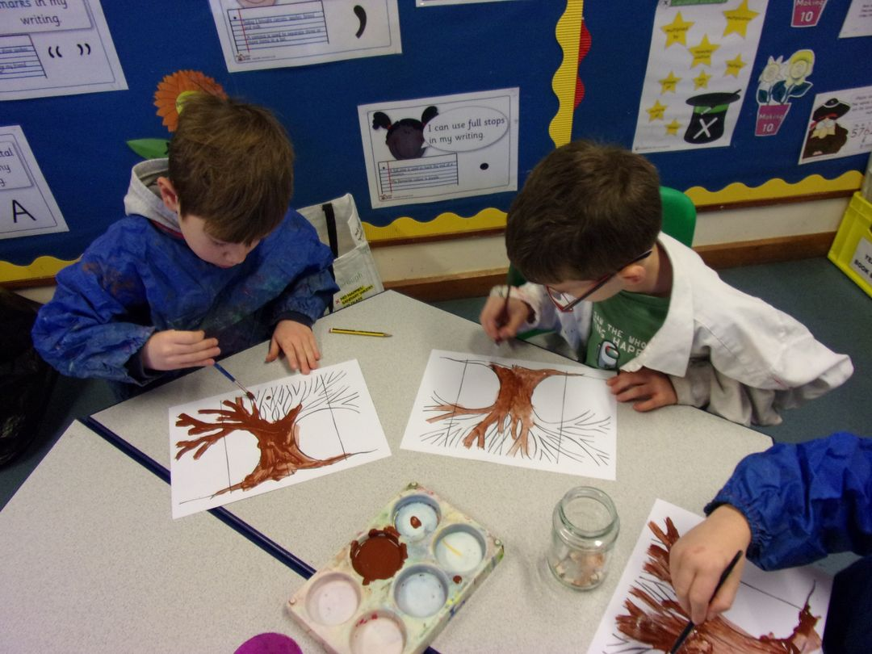
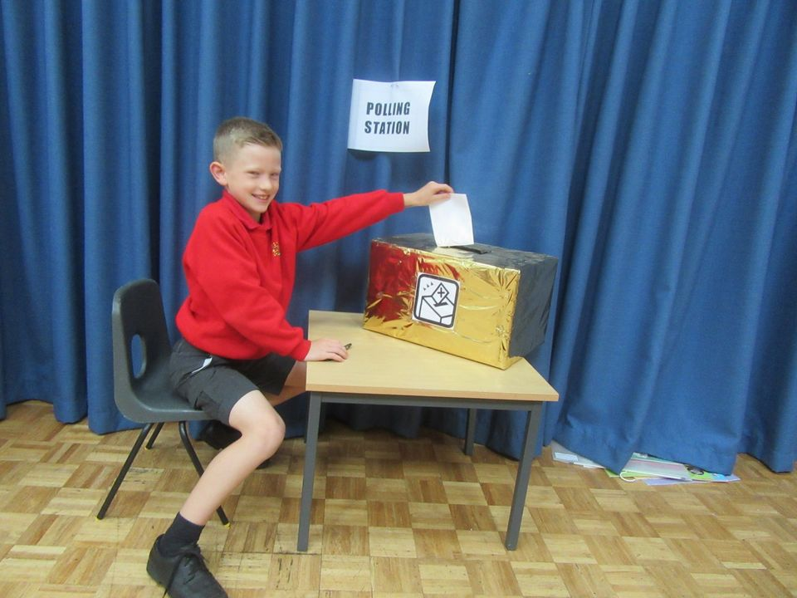
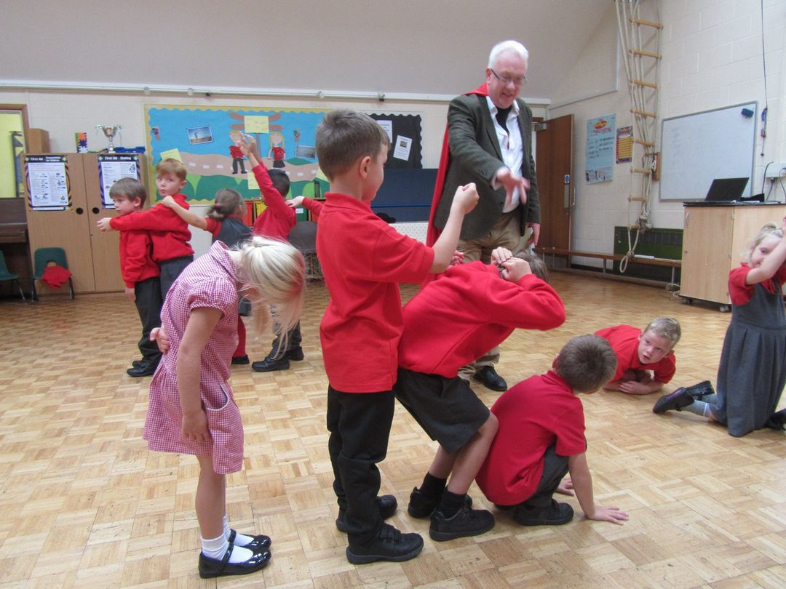
Taught
Assemblies
Visitors
PSHCE
Circle Time
15 minute character lesson
Journaling

Slide 14
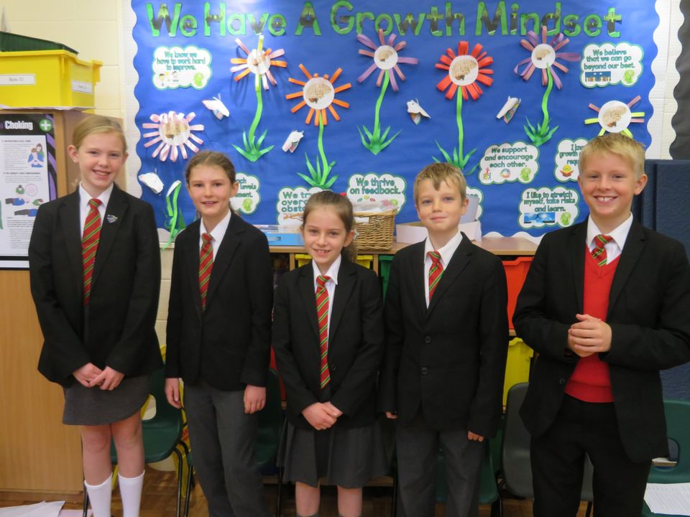


Caught
Values leaves
Reward charts
Special person certificates
House points

Slide 15
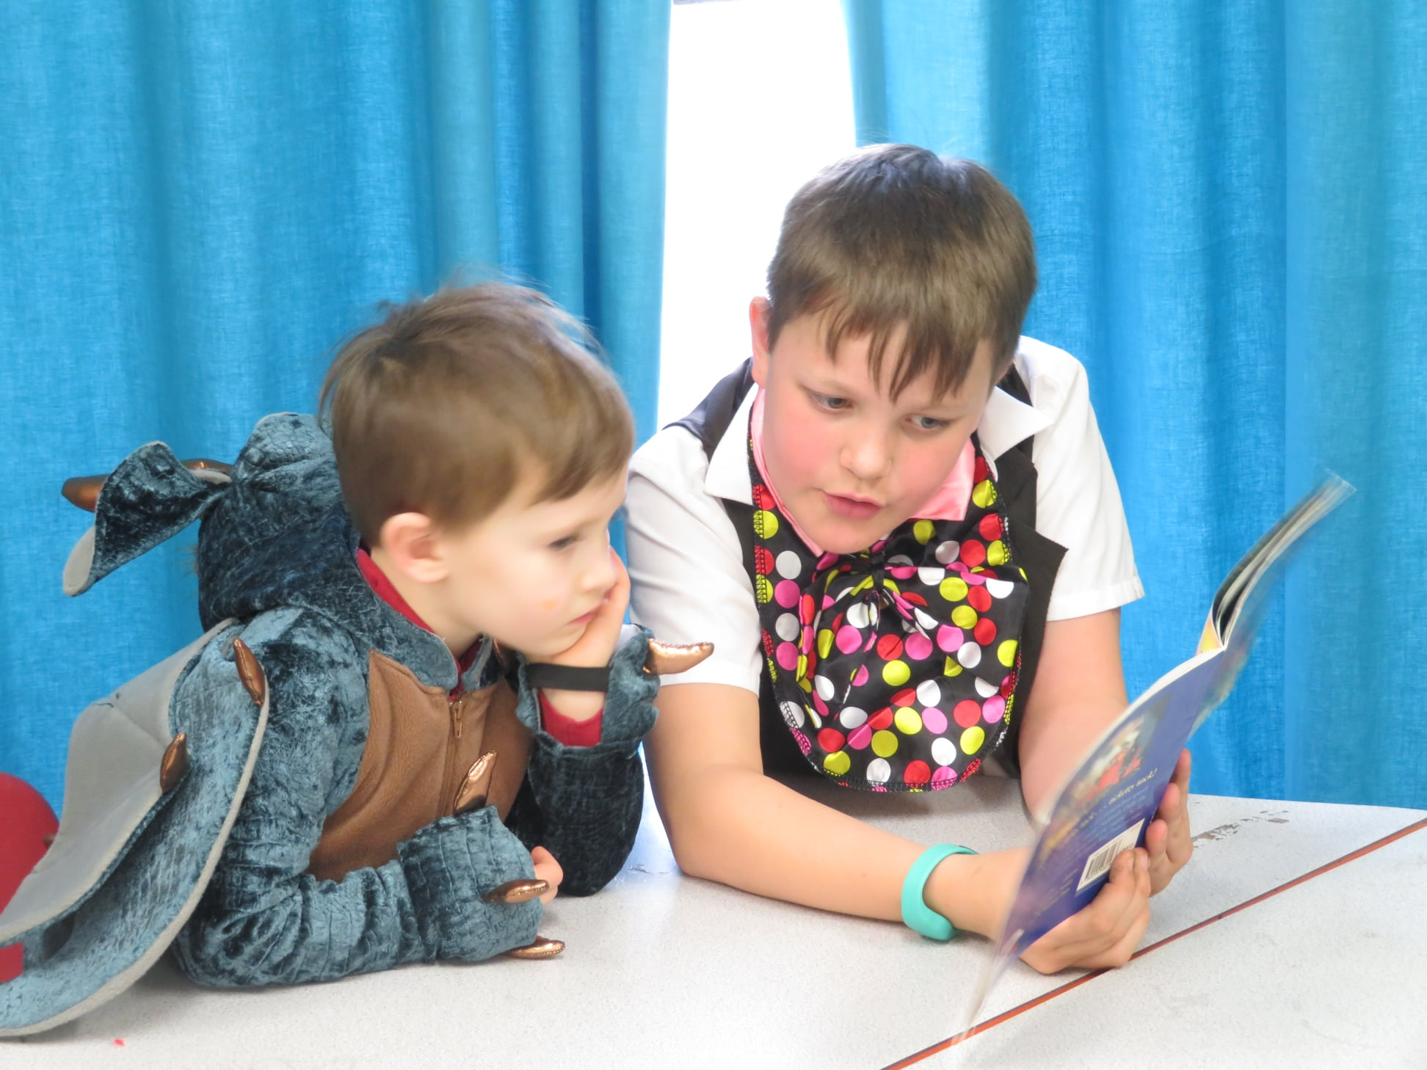
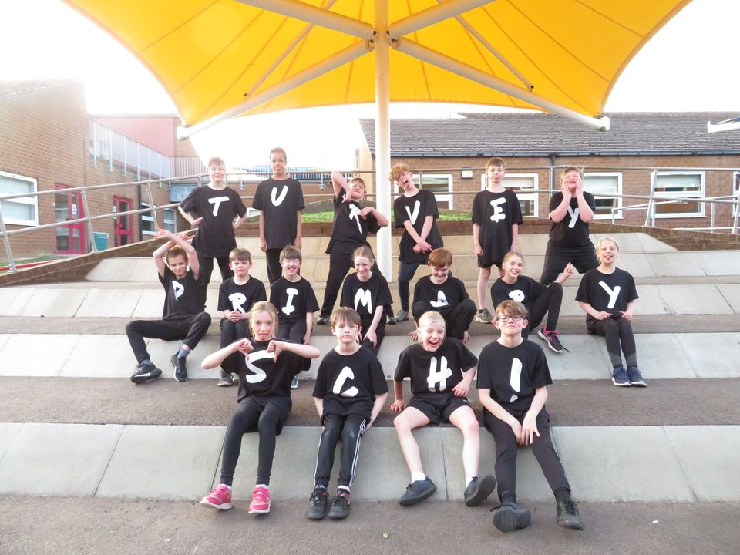
Sought
Leadership opportunities
School council & eco-council
House system
Community links
Sports teams
Performances
Opportunities to represent the school

Slide 16
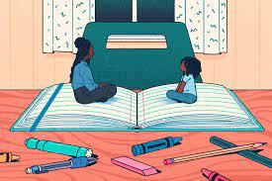
Additional Support
Some children need more support with their mental health and wellbeing. Sometimes this can be to create a "safe" place for the child to go when anxiety symptoms are high or during stressful times.
We are aware of physical symptoms of anxiety and will provide activities to distract/calm the child, such as reading or listening to music, preparing them for changes to routine and smoothing transitions between different parts of the day.

Slide 17

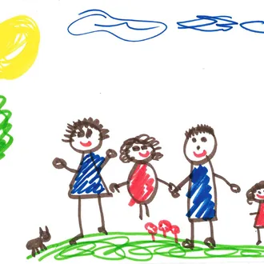
Intervention Programmes
Staff run a number of specific interventions and nurture groups to support pupils’ social, emotional and mental health needs.
Interventions include Drawing and Talking, an intervention to explore feelings in more depth, our Super Kids programme which seeks to boost self –esteem and tailored programmes to help pupils to voice and understand the anxiety that they are experiencing and use cognitive behavior techniques to help them manage this.

Slide 18
External support
Bedford Borough's Early Help service is able to offer support and advice regarding mild to moderate wellbeing and emotional health issues. The staff are trained to deliver a range of interventions with children and young people as well as offer advice and guidance to families and practitioners.
CHUMS provides a range of specialist services to support children in difficult circumstances, these include one to one counselling and group support for children and young people in Bedford Borough with mild to moderate mental health difficulties. Anyone can refer a child to the service, they also accept self-referrals.
The Child and Adolescent Mental Health Service (CAMHS) provides outpatient assessments, support and treatment for children and young people up to the age of 18 experiencing moderate to severe mental health problems. The service works to provide them with a greater knowledge of their condition and improve coping techniques.

Slide 19
Does my child need mental health support?
It’s normal to feel angry, sad, worried or stressed sometimes.
However, if they’re struggling to cope with those feelings, they might need support. Look out for:
Sudden changes in behaviour
Negative thoughts and low self-esteem
Arguing and fighting
Sleep problems
Avoiding school or staying with you all the time
Aches and pains
Remember – everyone is different and these signs might not have anything to do with a mental health problem.

Slide 20
Changes which may affect children
Death or illness in the family
Parents separating
Moving school or moving house
Tests and exams
Adolescence and puberty
Relationship and friendship problems

Slide 21
What to do at home
Find time to talk, just the two of you – ‘Check in’ with them while you’re doing things together, so they get used to talking about their feelings.
Play together – Play helps them to be curious, learn new things, solve problems and express feelings without words.
Be a role model – Show how you cope with difficult feelings and look after yourself.

Slide 22
Seeking help
We know that everyone experiences life challenges and may need additional emotional support from time to time.
If you are worried about your child’s mental health and wellbeing, you could:
Speak to their class teacher, Mrs Gibson as Mental Health Lead, or Mrs Coles as SENCO and Mental Health first aider about your concerns. We may be able to put in place additional support, or signpost you to further help
Speak to your GP – they are a useful place to gain medical support and signpost to local services.

Slide 23
Further Signposts
NHS
Young Minds
MindEd
Place2Be
NSPCC

